Slide 1
LEAF DISEASE DETECTION USING DEEP LEARNING
NAME: RAVIKANTH GADDAM
CWID: 20018536

Slide 2
Introduction
The capability to grow enough food to suit the needs of more than 7 billion people has been provided by modern technologies.
However, Plant diseases are a danger to global food security, but they may also have negative impacts on smallholder farmers whose livelihoods depend on producing healthy crops.
This project is implementation of Deep Learning techniques that takes plant photos using machine vision equipment and determines whether they contain any pests and illnesses.
Because of powerful computers, broad built-in accessory sets, such as high-definition cameras, smartphones in particular offer extremely Technologies to aid in the identification of diseases in plant leaves using the image classification techniques.

Slide 3
Problem statement
Due to several diseases in agricultural crops, farmers experience financial loss and crop waste every year.
Use of automated disease detection techniques is beneficial for spotting plant diseases in their earliest stages.
It is difficult to manually diagnose plant disease using photographs of the leaves.
Thus, it is necessary to create computing techniques that would automate the disease identification and categorization using leaf images.
Creating a system that can detect and determine the kind of disease is the objective of this project.

Slide 4
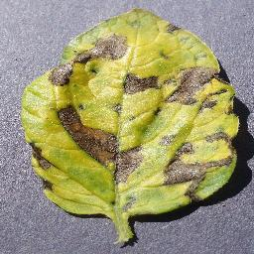
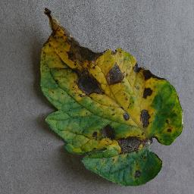
Dataset used
Dataset credits: Plant Village | Kaggle
The PlantVillage dataset consists of 54303 healthy and unhealthy leaf images divided into 38 categories by species and disease.
I selected 4500 photographs of tomato plants for the training and validation of a deep learning model out of a total of 54303 images of various plant classes.

Slide 5
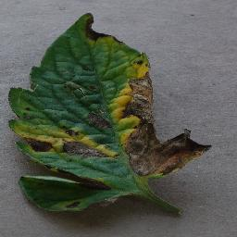
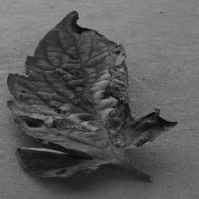
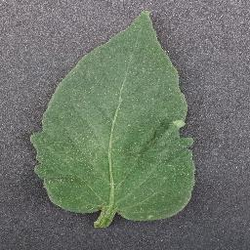
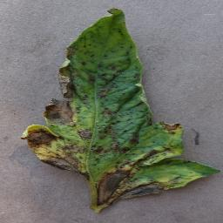
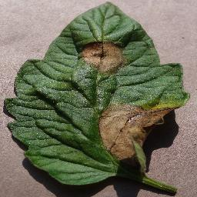
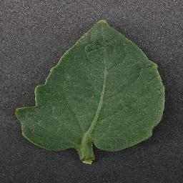
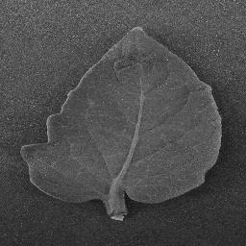
Choice of dataset type
Color images
Gray scale images
3 classes of tomato plant dataset:
Healthy Leaf
Early blight
Late blight

Slide 6
Choice of training mechanism
Transfer Learning:
A method of reusing an already trained model for another task.
Various CNN models pre-trained on ImageNet data have proven successful in different medical tasks
MODELS CREATED USING TRANSFER LEARNING
Training from Scratch:
This is an implementation of a CNN (one convolutional function, one non-linear function, one max pooling function and one softargmax function).
Building and training a Convolutional Neural Network (CNN) from scratch
Prepare the training and testing data.
Build the CNN layers using the TensorFlow library.
Select the Optimizer.
Train the network and save the checkpoints.
Finally, we test the model.
VGG19
INCEPTIONV3
ResNet50
ResNet 152 V2

Slide 7
Choice of deep learning architecture:
ALGORITHMS USED
CONVOLUTIONAL NEURAL NETWORK (BUILT LAYER BY LAYER FROM SCRATCH)
VGG19
RESNET50
RESNET 152 V2
INCEPTIONV3

Slide 8
LIBRARIES USED
TENSORFLOW
KERAS
NUMPY
MATPLOTLIB
SEABORN
SCIKIT LEARN

Slide 9
DATA PRE-PROCESSING
RESIZING IMAGES :
The formats, quality, and resolution of the images in the dataset may vary. Thus, the photographs must be preprocessed.
For example: Images having a resolution of less than 500 px and dimensions of less than 500 px will not be accepted as valid images for the dataset.
In order to shorten the training period, the remaining portions will be scaled to 256 x 256.
DATA AGUMENTATION :
Data augmentation is the technique of creating additional data points from current data in order to artificially increase the amount of data.
most popular types of image augmentation.
Vertical shift
Horizontal shift
Vertical flip
Horizontal flip
Rotation
Brightness modification
Zoom In/Out most popular types of image augmentation.

Slide 10
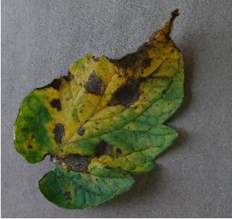
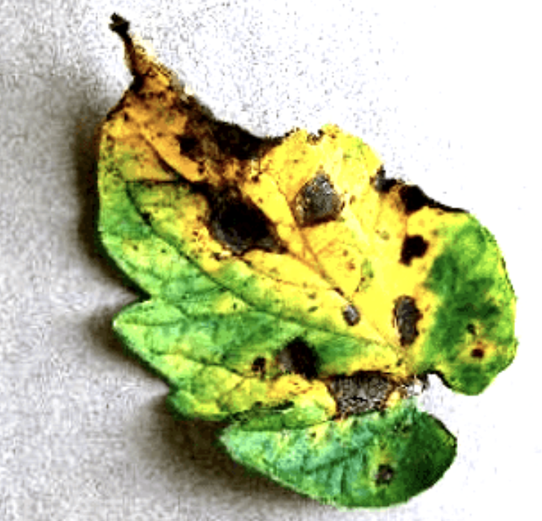
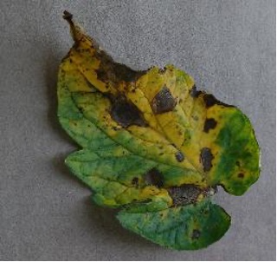
IMAGE-DATA-GENERATOR
Keras ImageDataGenerator class provides a quick and easy way to augment your images.
ImageDataGenerator apply random transformations to each individual image as it is passed to the model so that it never sees the exact same image twice during training.
Vertical Flip
IMAGE AUMENTATION WITH IMAGE-DATA-GENERATOR
Horizontal Flip
Vertical Flip
Brightness Adjustment
360-degree Rotation
Brightness Adjustment
Horizontal Flip

Slide 11
ALGORITHMS & RESULTS

Slide 12
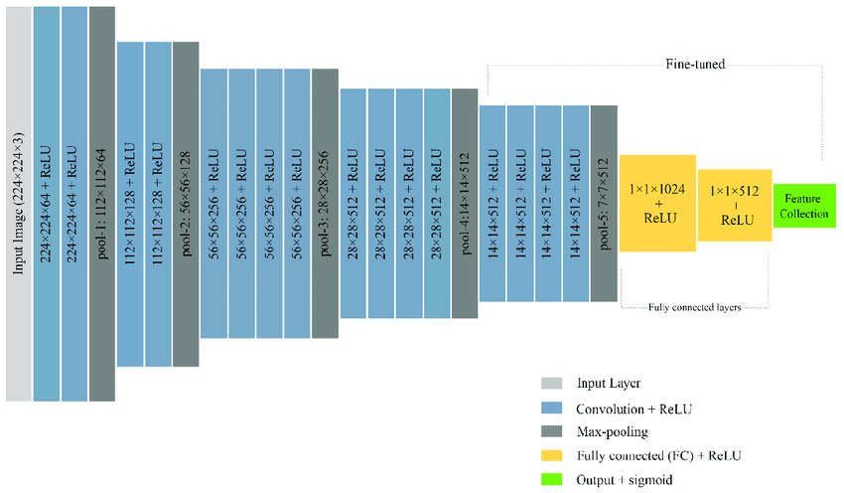
Algorithm-1
VGG19:
VGG stands for Visual Geometry Group.
VGG19 is a variant of VGG model which in short consists of 19 layers.
(16 convolution layers, 3 Fully connected layer, 5 Max-Pooling layers and 1 SoftMax layer).
Assigning weights are easily available with other frameworks like keras.

Slide 13
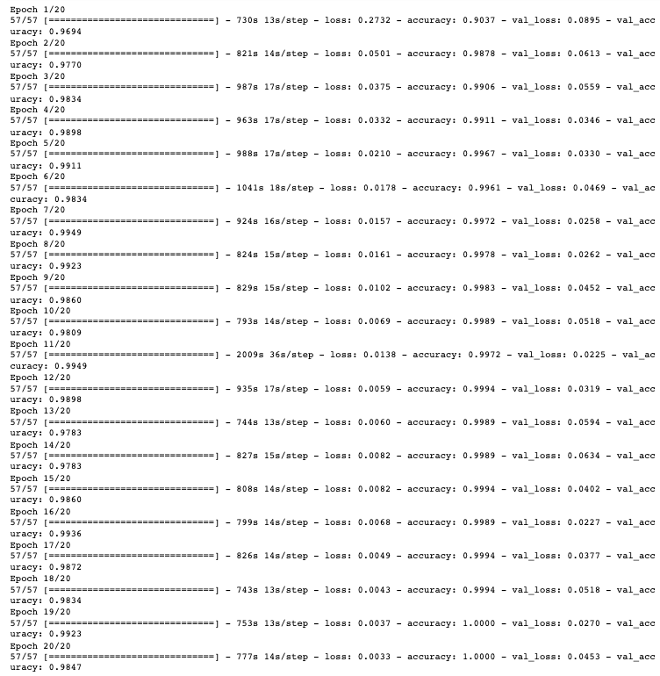
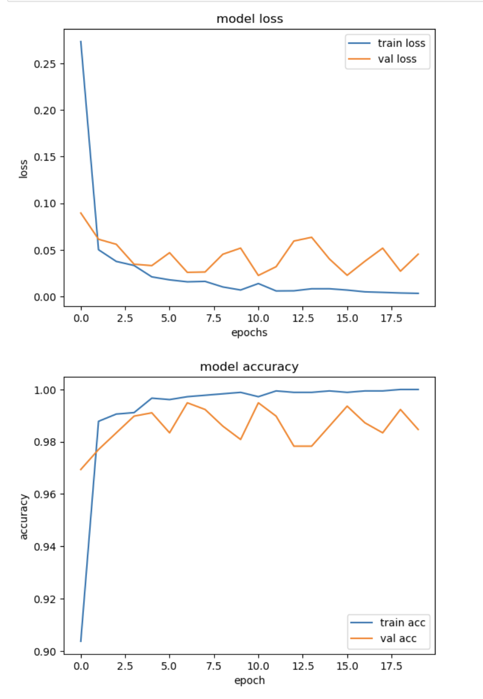
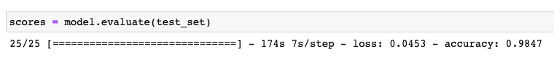
VGG19 Results
Model Building & Training Phase
Learning Curve
Model Accuracy = 98.47%

Slide 14
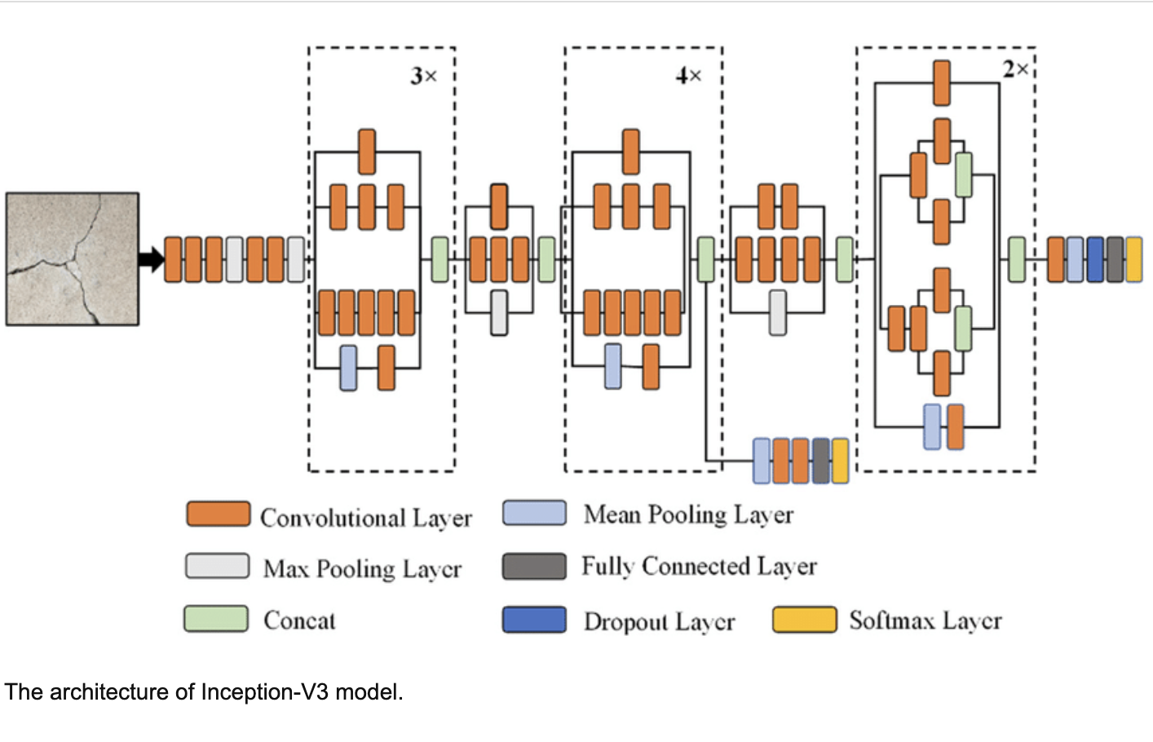
Algorithm-2
InceptionV3:
Inception-v3 is a convolutional neural network that is 48 layers deep.
To avoid overfitting cases, The inception V3 model uses idea of using multiple filters of different sizes on the same level.
It is computationally less expensive.
It has higher efficiency

Slide 15
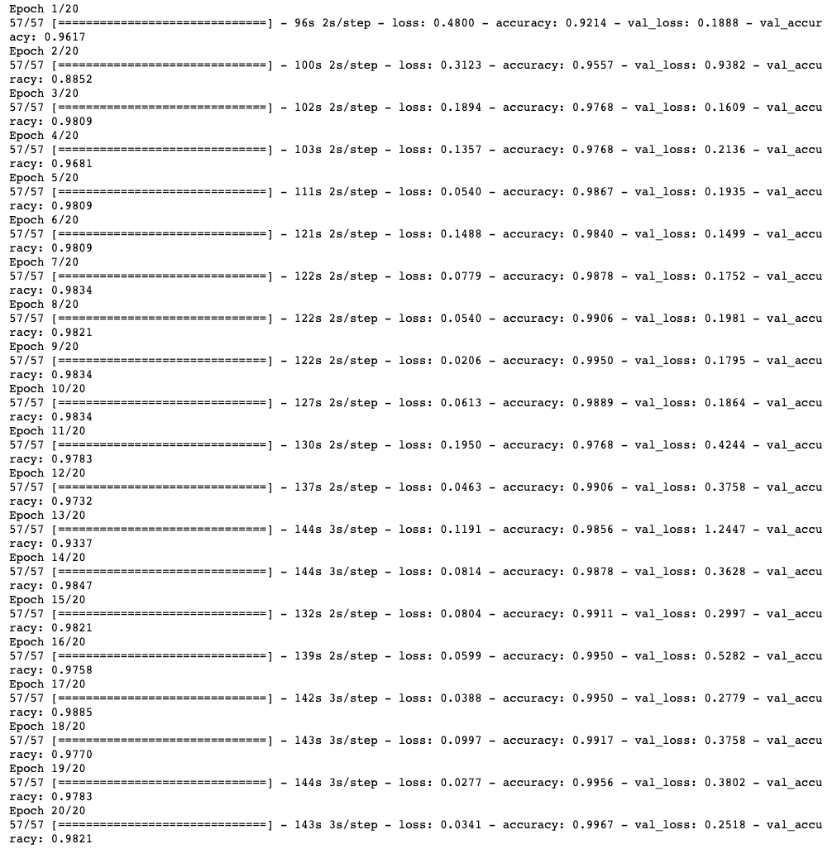
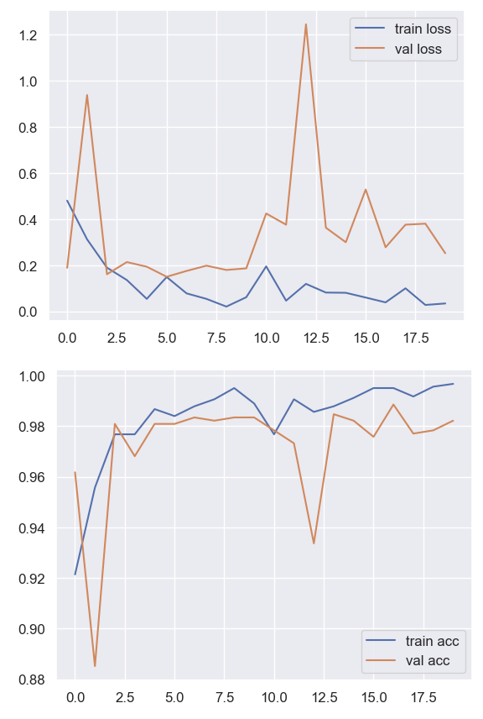
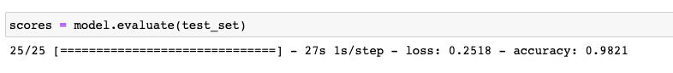
InceptionV3 Results
Model Building & Training Phase
Learning Curve
Model Accuracy = 98.21%

Slide 16
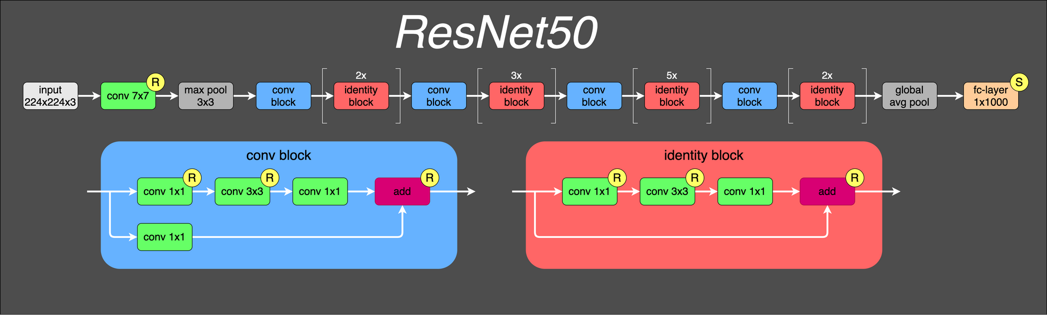
Algorithm-3
ResNet50:
ResNet stands for Residual Network and is a specific type of convolutional neural network (CNN)
ResNet-50 is a 50-layer convolutional neural network (48 convolutional layers, one MaxPool layer, and one average pool layer).
The 50-layer ResNet uses a bottleneck design for the building block, which reduces the number of parameters and matrix multiplications.
This enables much faster training of each layer

Slide 17
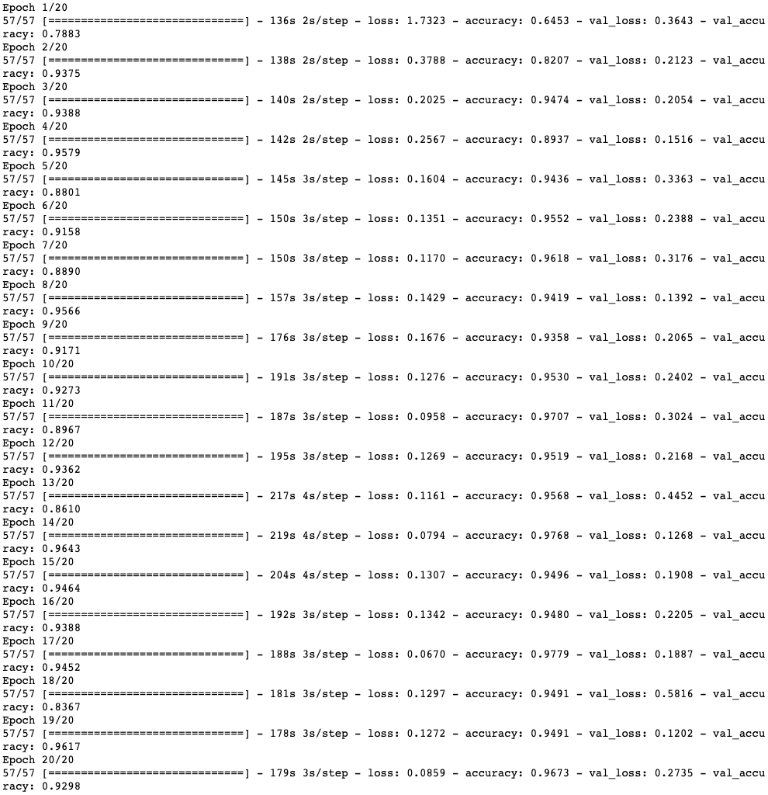
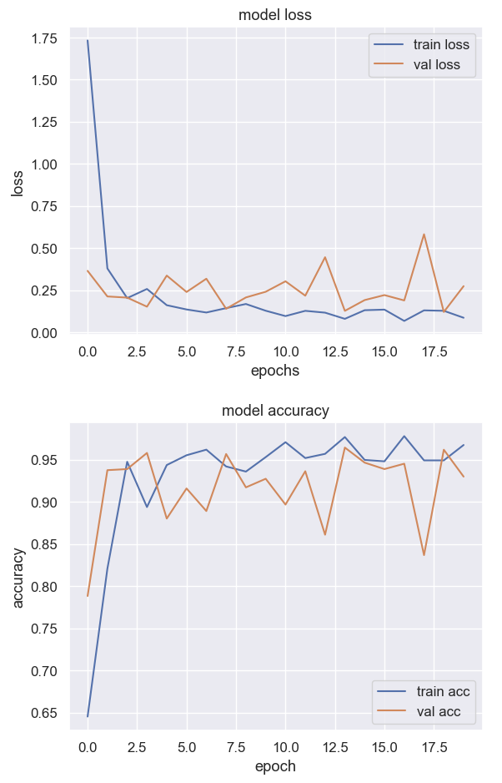
ResNet50 Results
Model Building & Training Phase
Learning Curve
Model Accuracy = 92.98%

Slide 18
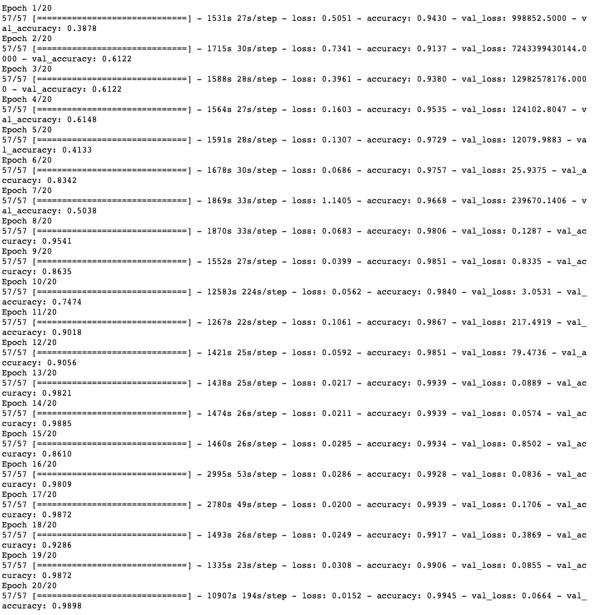
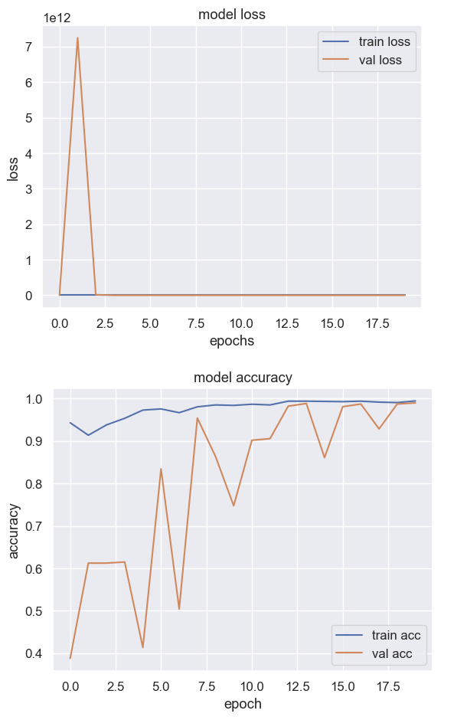
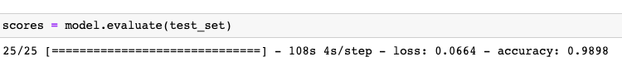
ALGORITHM- 4 ResNet 152 V2 Results
Model Building & Training Phase
Learning Curve
Model Accuracy = 98.98%

Slide 19
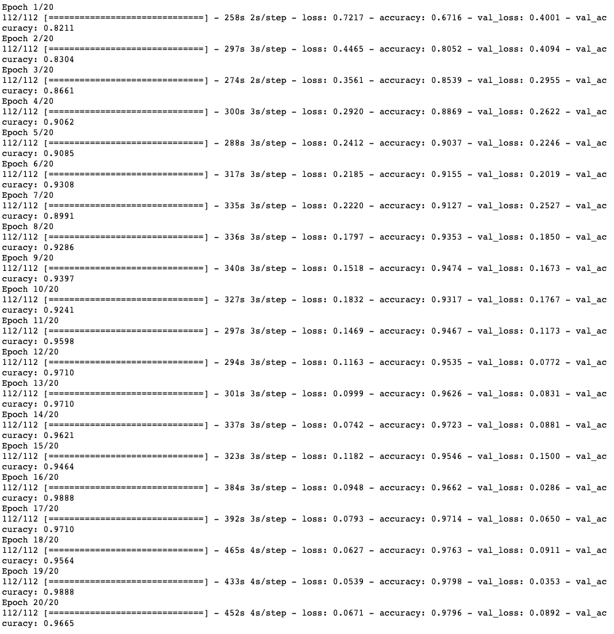
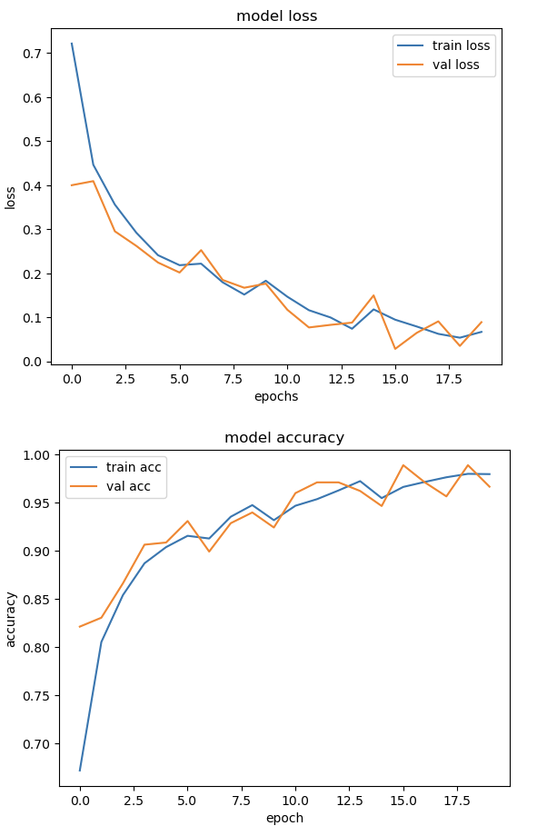
ALGORITHM- 5 Results of CNN ( Built Layer by Layer )
Model Building & Training Phase
Learning Curve
Model Accuracy = 97.08%

Slide 20
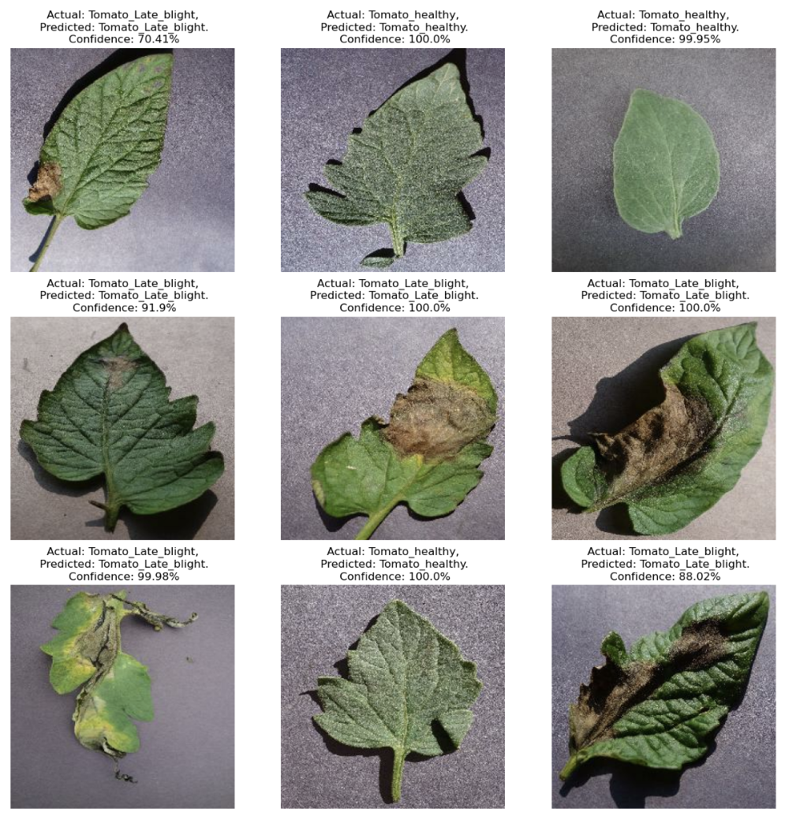
ALGORITHM- 5 Results of CNN ( Built Layer by Layer )
Prediction on few sample images

Slide 21
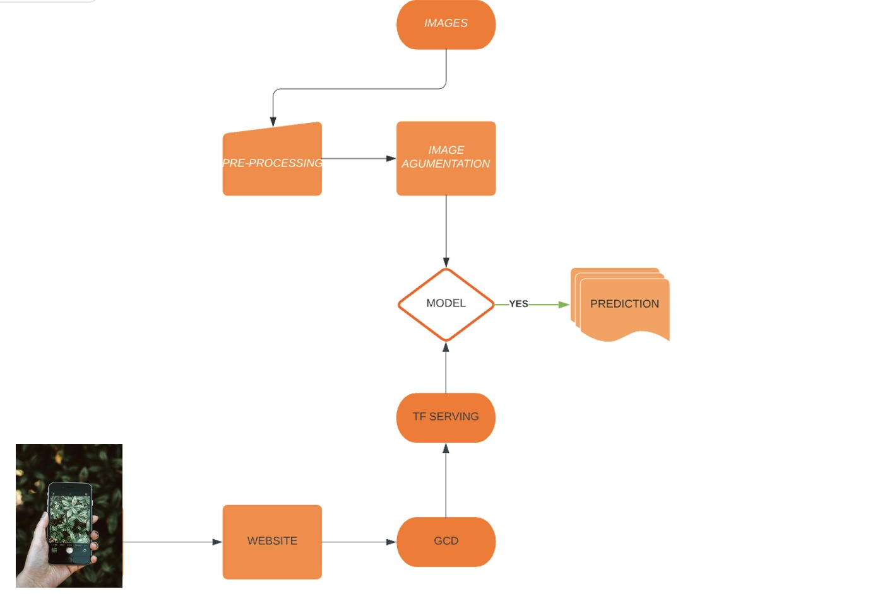
REAL LIFE APPLICATION

